Slide 1
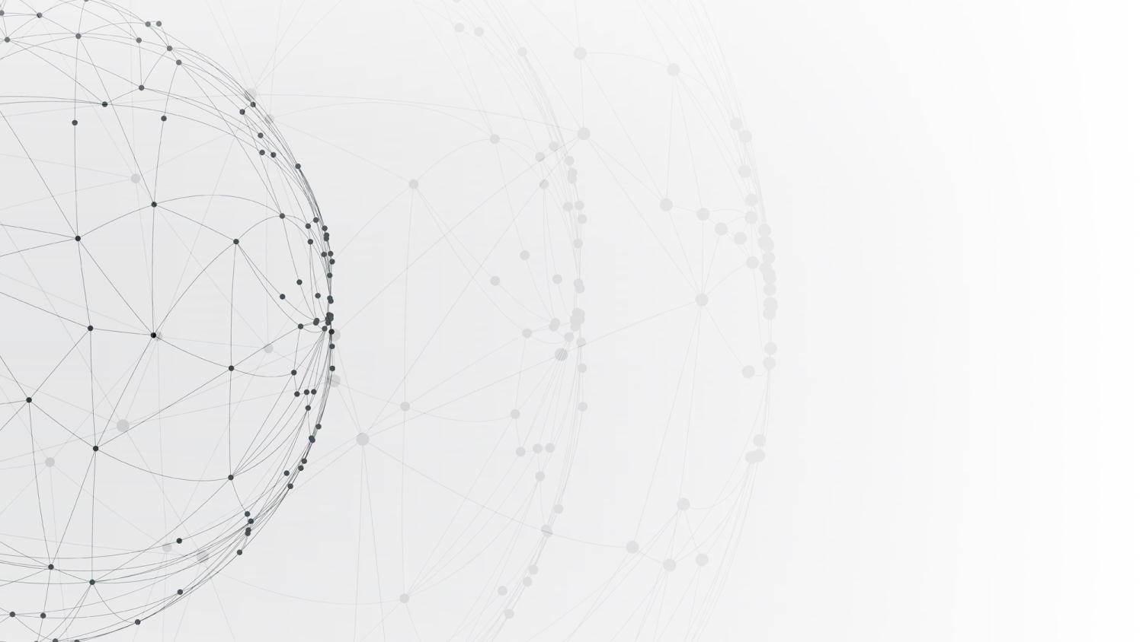
Wireless Communications
Project: OFDM Technology
Members: 12011104 岳翼遥
12012128 孙逸涵
12011923 张旭东
Date: 2022.12.14

Slide 2
CONTENTS
Introduction
01
02
Theory
03
Basic Task
04
Advanced Task
05
Q&A

Slide 3
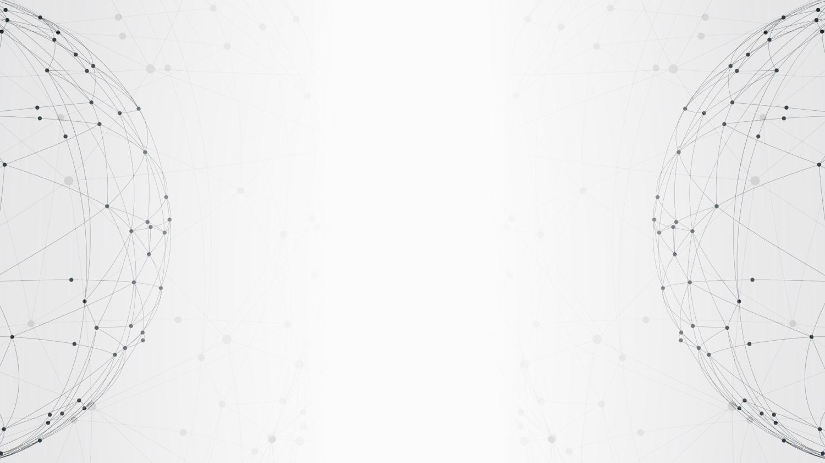
01
PART
Introduction

Slide 4
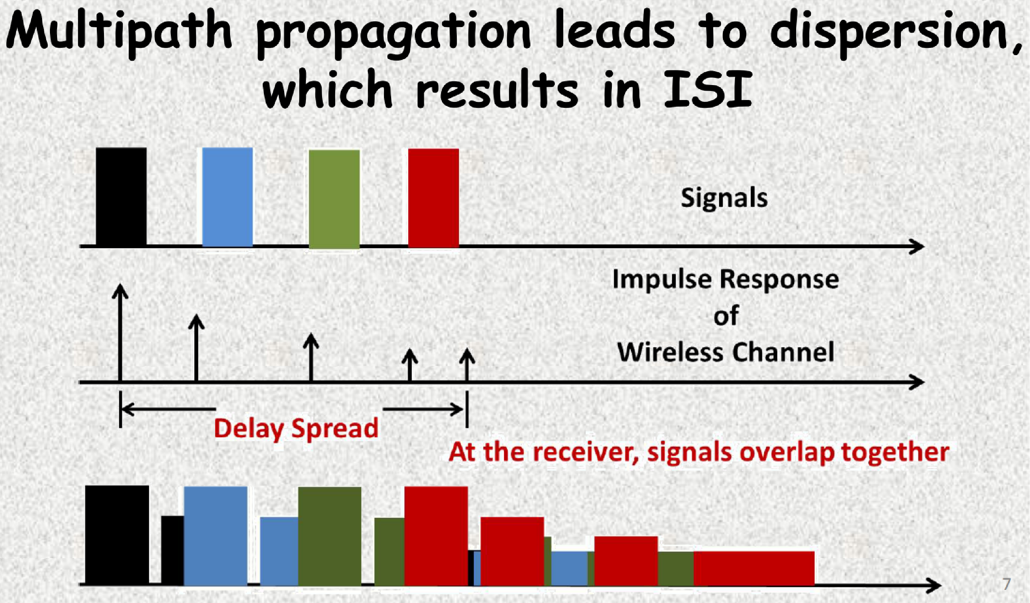
Introduction
EE313: Wireless Communications
4

Slide 5
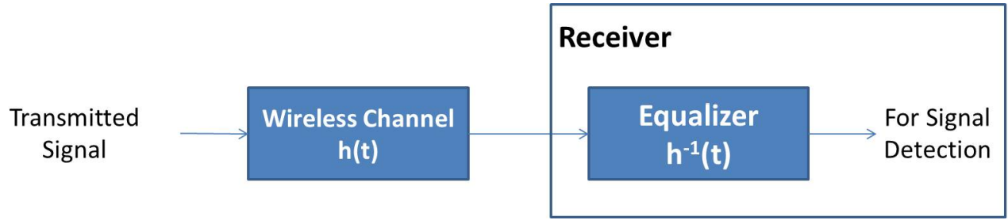
Introduction
How to deal with ISI ?
Approach 1: Increase the time interval to make it larger than the delay extension of multipath effect.
But it will reduce data transfer rate.
Approach 2: Channel equalizer.
Maximum delay
Complexity
Approach 3: Orthogonal Frequency Division Multiplexing (OFDM) is a digital multi‐carrier modulation technique extending the concept of single subcarrier modulation by using multiple sub-carriers over the channel.
EE313: Wireless Communications
5
Notes:
As the maximum delay increases, the complexity of equalizers is correspondingly more and more complicated, which leads to the high computational complexity and unrealizable.
In particular, the number of taps required for an equalizer with good performance in a high–data-rate system is typically large. Thus, these equalizers are quite complex. Moreover, it is difficult to maintain accurate weights for a large number of equalizer taps in a rapidly varying channel.
Thus, most emerging high-rate wireless systems use multicarrier modulation

Slide 6
Introduction
Advantages of OFDM technology
Spectra efficiency
Against frequency selective fading
The ISI can be completely eliminated through the use of a cyclic prefix
Use multi-subcarriers to decrease the complexity of equalizer
Application of OFDM technology
4G mobile communication system
Multi Input Multi Output (MIMO) technology
Ultra Wide Band (UWB) radios
IEEE 802.11a Wireless LAN
Digital Audio Broadcasting (DAB)
HiperLAN/2 (High Performance Radio LAN)
EE313: Wireless Communications
6
Notes:
中国的UWB标准采用了OFDM双载波技术,包含两个载波的OFDM超宽带信号进行数据传输
数字音频广播 (DAB)
HiperLAN是一种在欧洲应用的无线局域网通讯标准的一个子集

Slide 7
02
PART
Theory
EE313: Wireless Communications
7

Slide 8
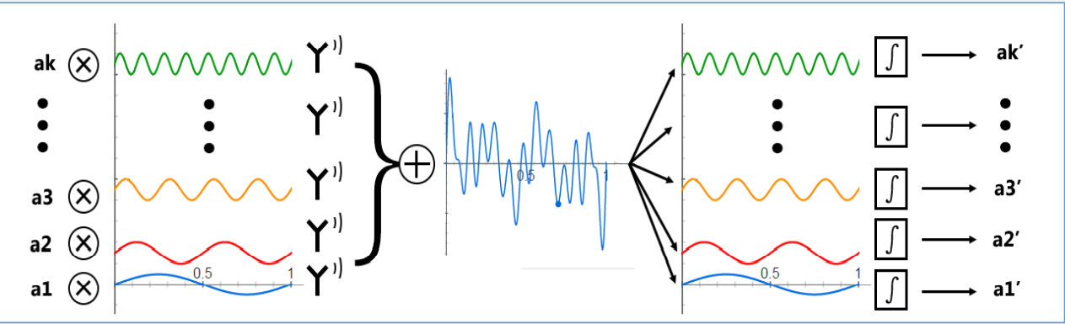
Basic idea of OFDM
Think of the modulation symbol as the spectrum of the signal
IFFT at the transmitter
FFT at the receiver
Parallel transmission mode
EE313: Wireless Communications
8

Slide 9
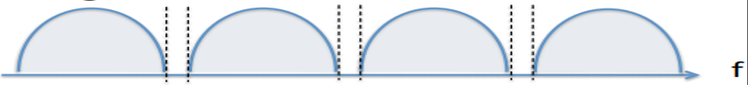
Basic idea of OFDM
Improve frequency band utilization rate
EE313: Wireless Communications
9

Slide 10
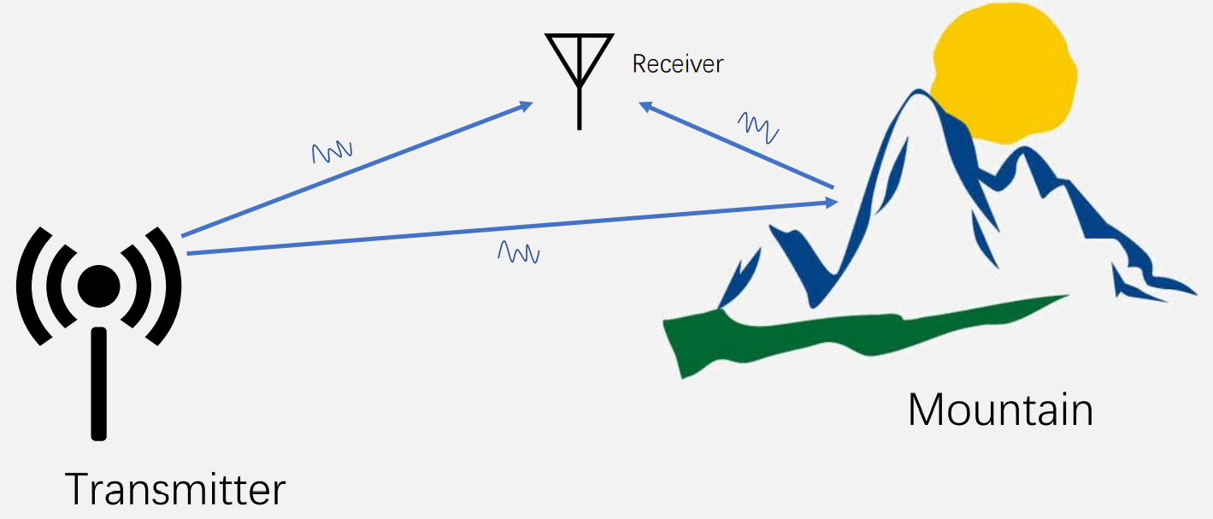
Multipath Propagation
EE313: Wireless Communications
10

Slide 11
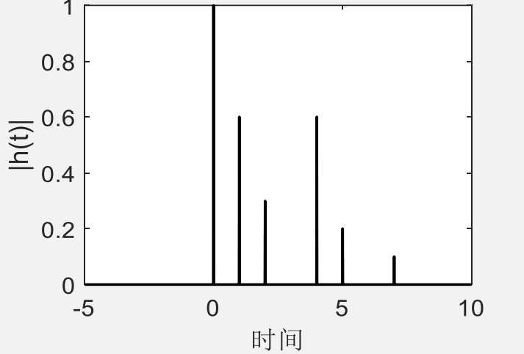
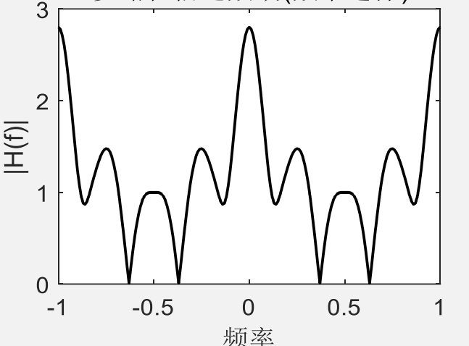
Multipath Propagation
Frequency selective fading
EE313: Wireless Communications
11

Slide 12
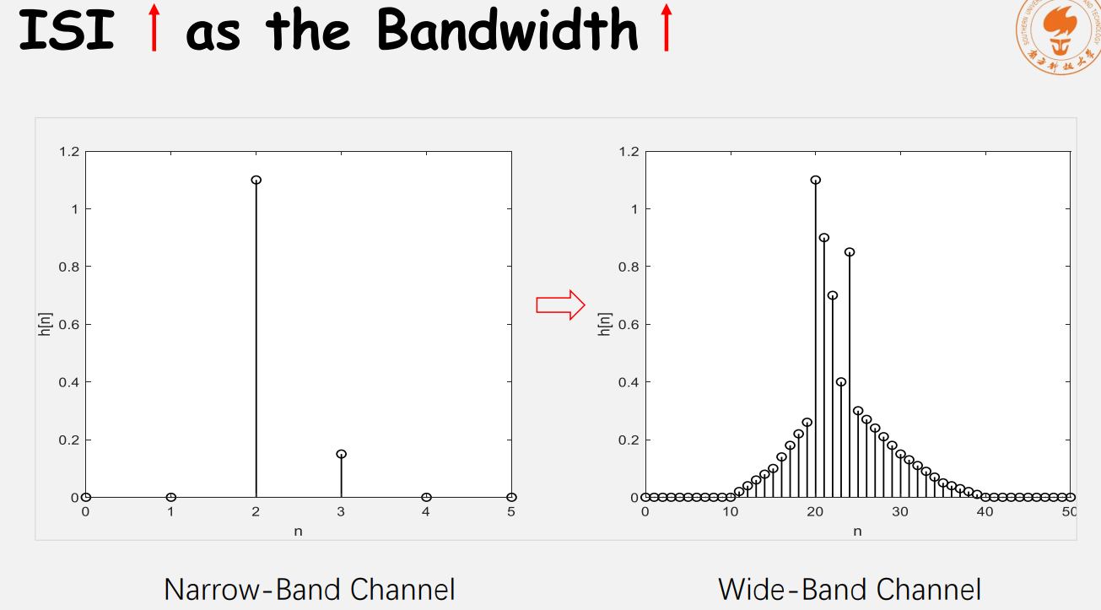
Multipath Propagation
EE313: Wireless Communications
12

Slide 13
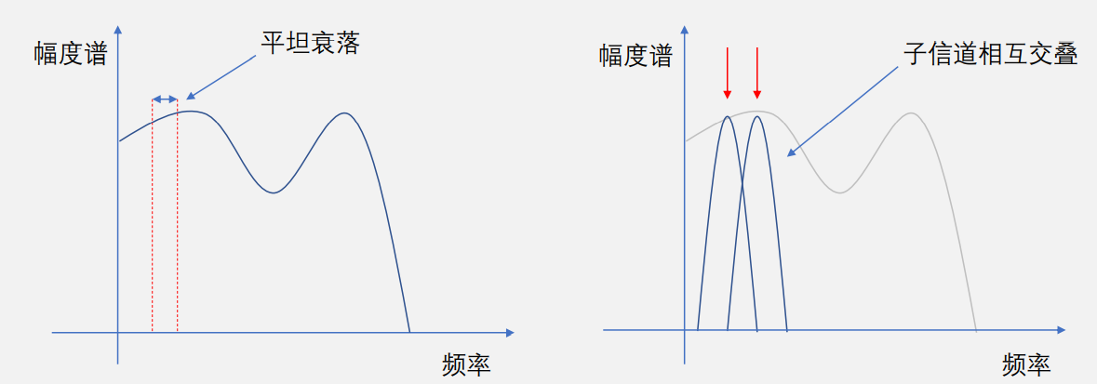
Multipath Propagation
Subchannel flat fading
subchannel overlap
Sample at zero crossing
EE313: Wireless Communications
13

Slide 14
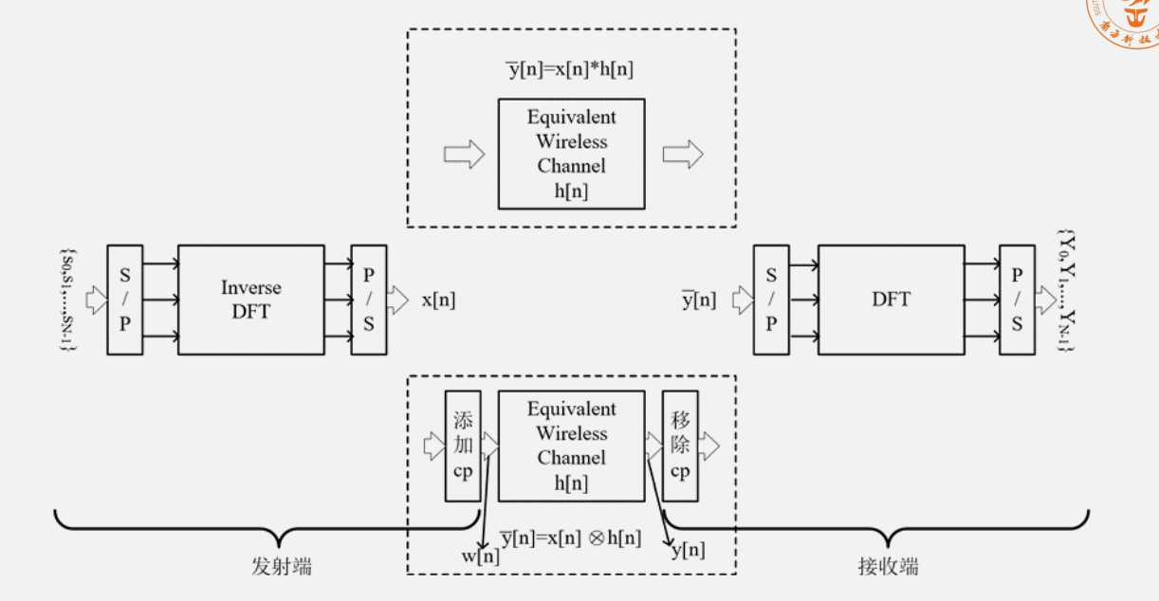
Adding Cycle Prefix
EE313: Wireless Communications
14

Slide 15
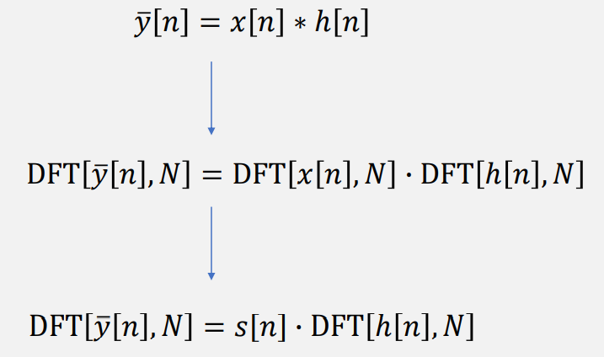
Adding cycle prefix
N≥length(x[n])+length(h[n])-1
EE313: Wireless Communications
15

Slide 16
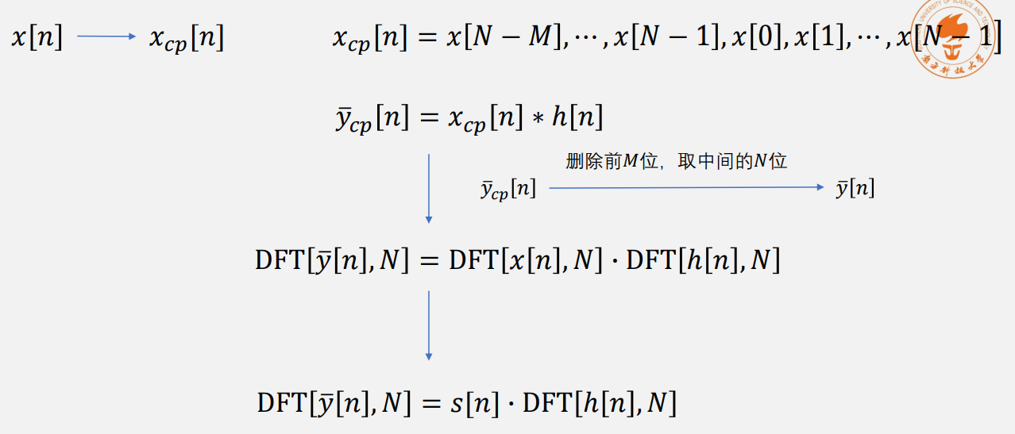
Adding Cycle Prefix
M＞Delay extension of multipath propagation
EE313: Wireless Communications
16

Slide 17
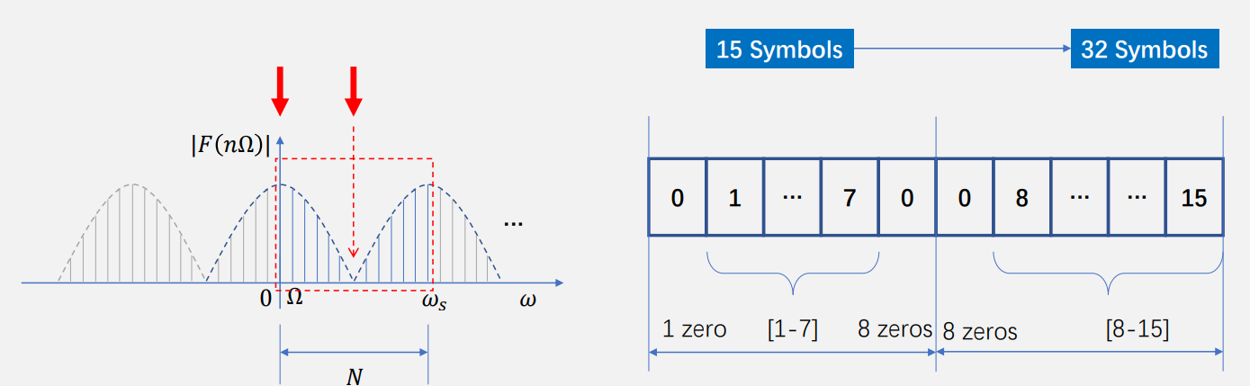
Insert None Tone
Insert 0 into the high-frequency component, which can avoid the transmission of high-frequency components.
Place the sequence at low frequency,easy to increase the length of the original sequence.
EE313: Wireless Communications
17

Slide 18
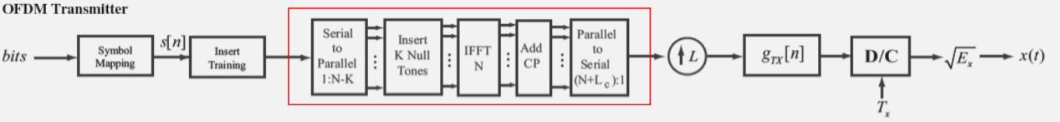
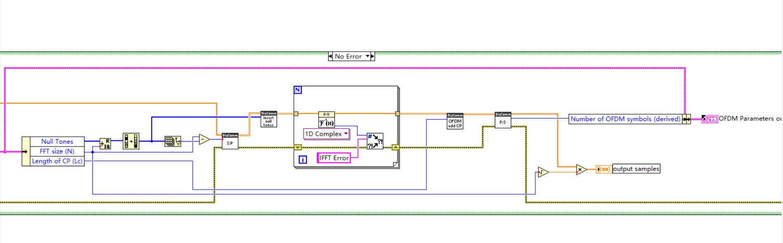
OFDM Transmitter
EE313: Wireless Communications
18

Slide 19
OFDM Transmitter
Convert serial input stream to parallel stream, size =N-K
Insert K null tones， size=N
Perform N IFFT
Add cycle prefix
Convert parallel stream to serial stream, size=N+Lc
EE313: Wireless Communications
19

Slide 20
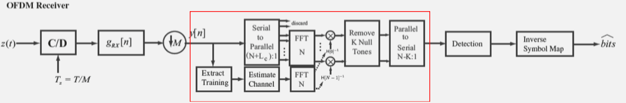
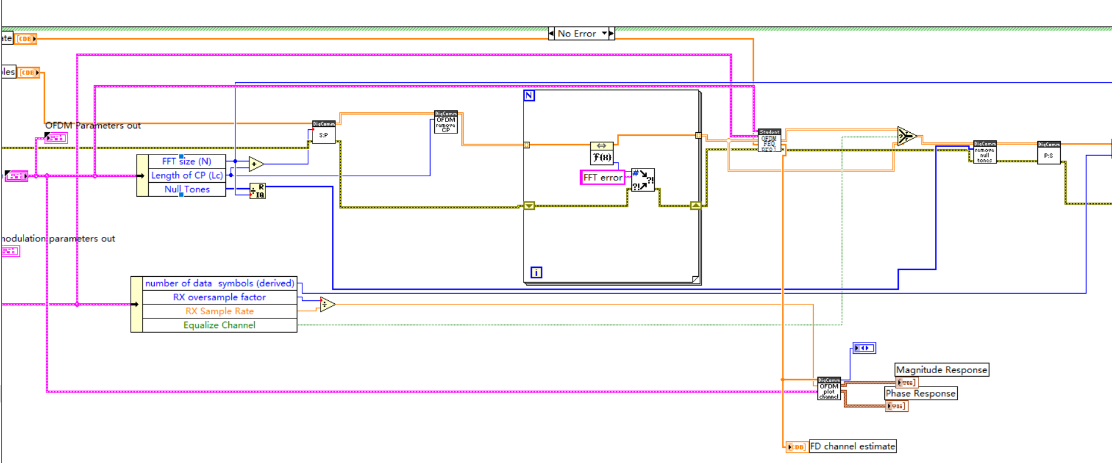
OFDM Receiver
EE313: Wireless Communications
20

Slide 21
OFDM Receiver
Convert serial input stream to parallel stream, size = N+Lc
Remove cycle prefix， size=N
Perform N FFT
Apply frequency domain equalizier
Remove null tones，size =N-k
Convert parallel stream to serial stream
EE313: Wireless Communications
21

Slide 22
03
PART
Basic Task
EE313: Wireless Communications
22

Slide 23
Task1: Programming for OFDM Transceiver
EE313: Wireless Communications
23

Slide 24
Task2: Frequency Selectivity of Wireless Channels——Simulation
EE313: Wireless Communications
24

Slide 25
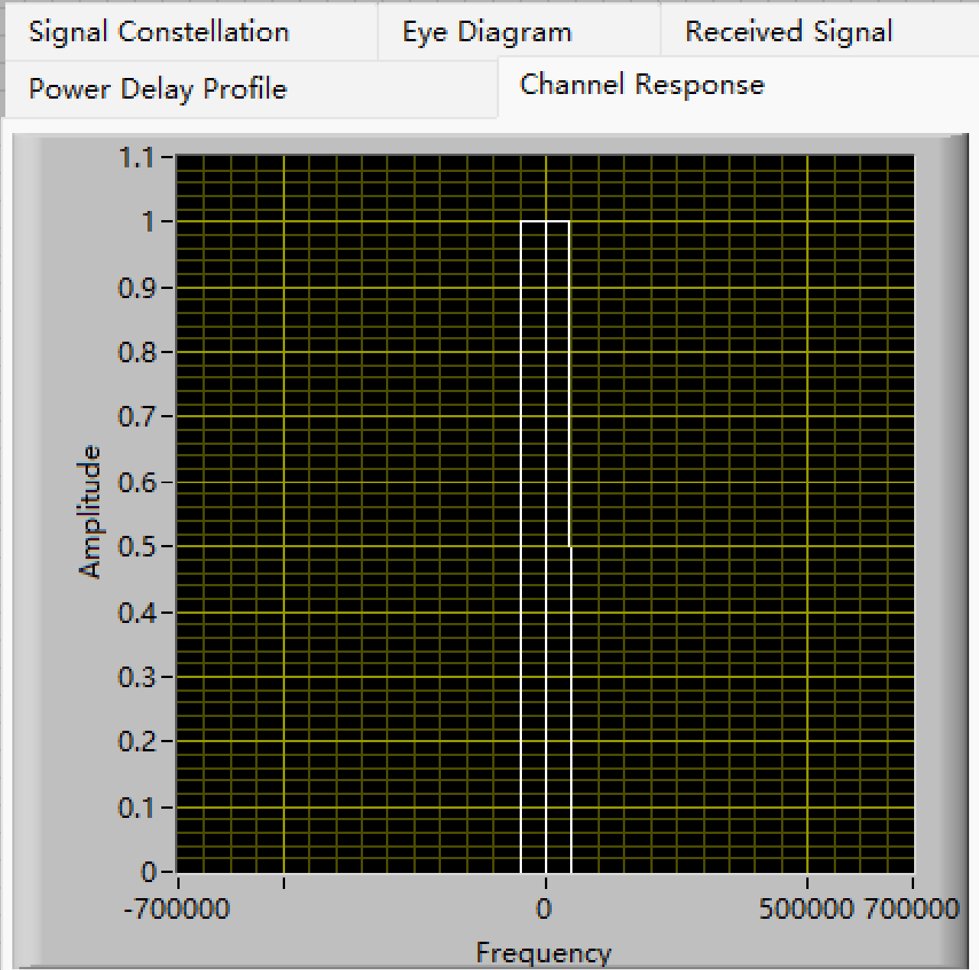
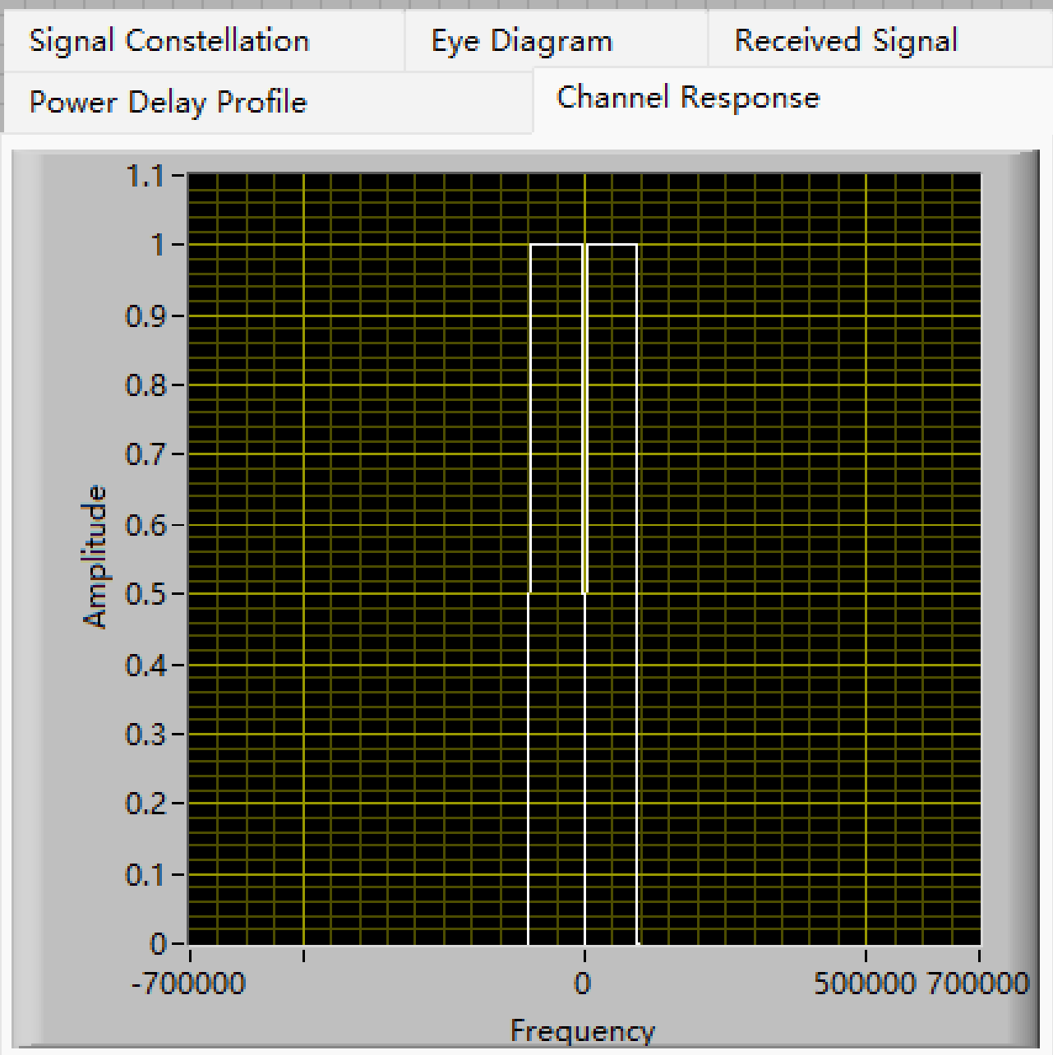
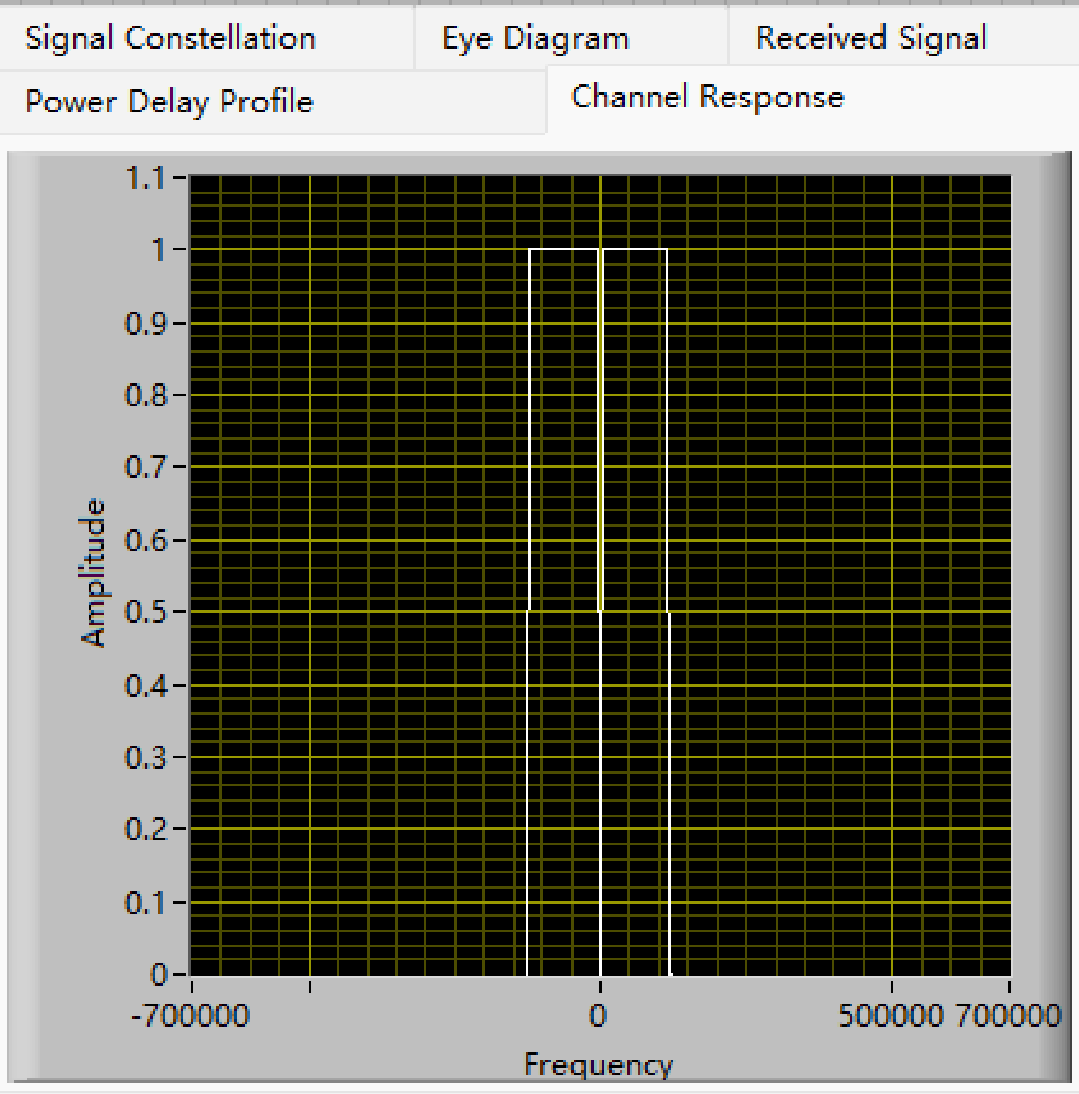
Task2: Frequency Selectivity of Wireless Channels——Simulation
SampleRate=400KHz
SampleRate=800KHz
SampleRate=1MHz
EE313: Wireless Communications
25

Slide 26
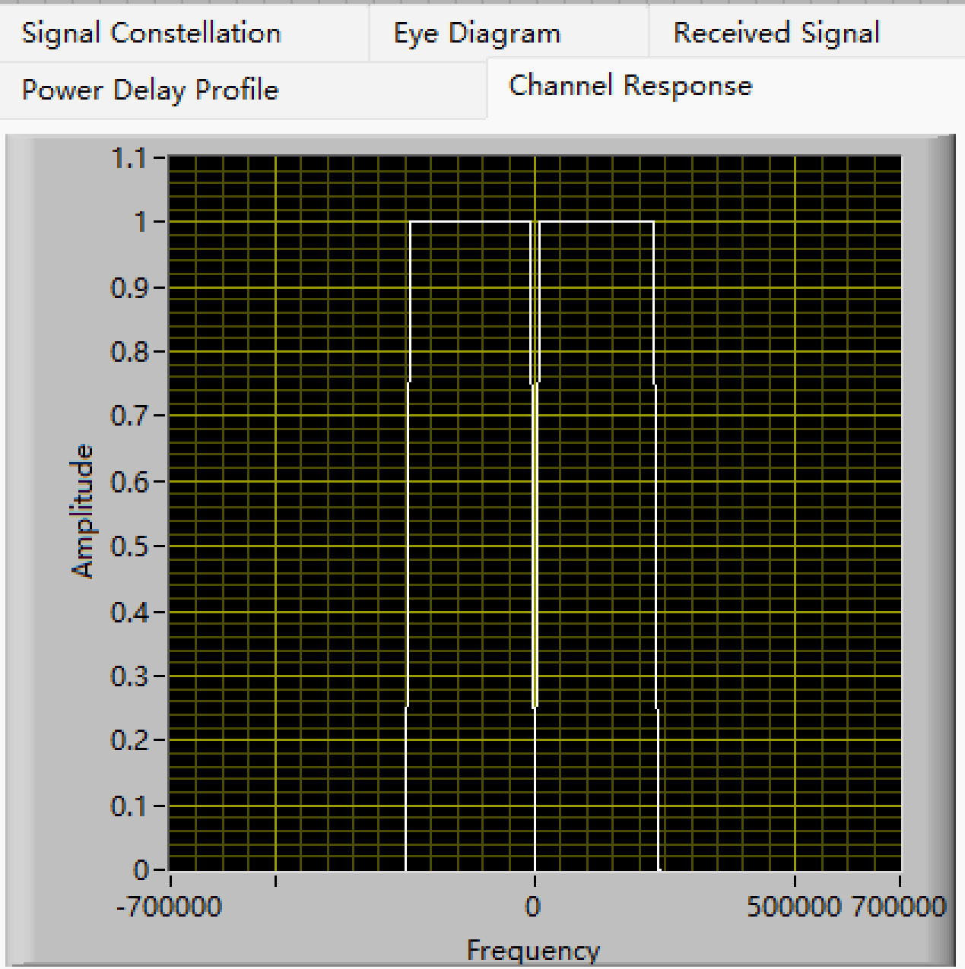
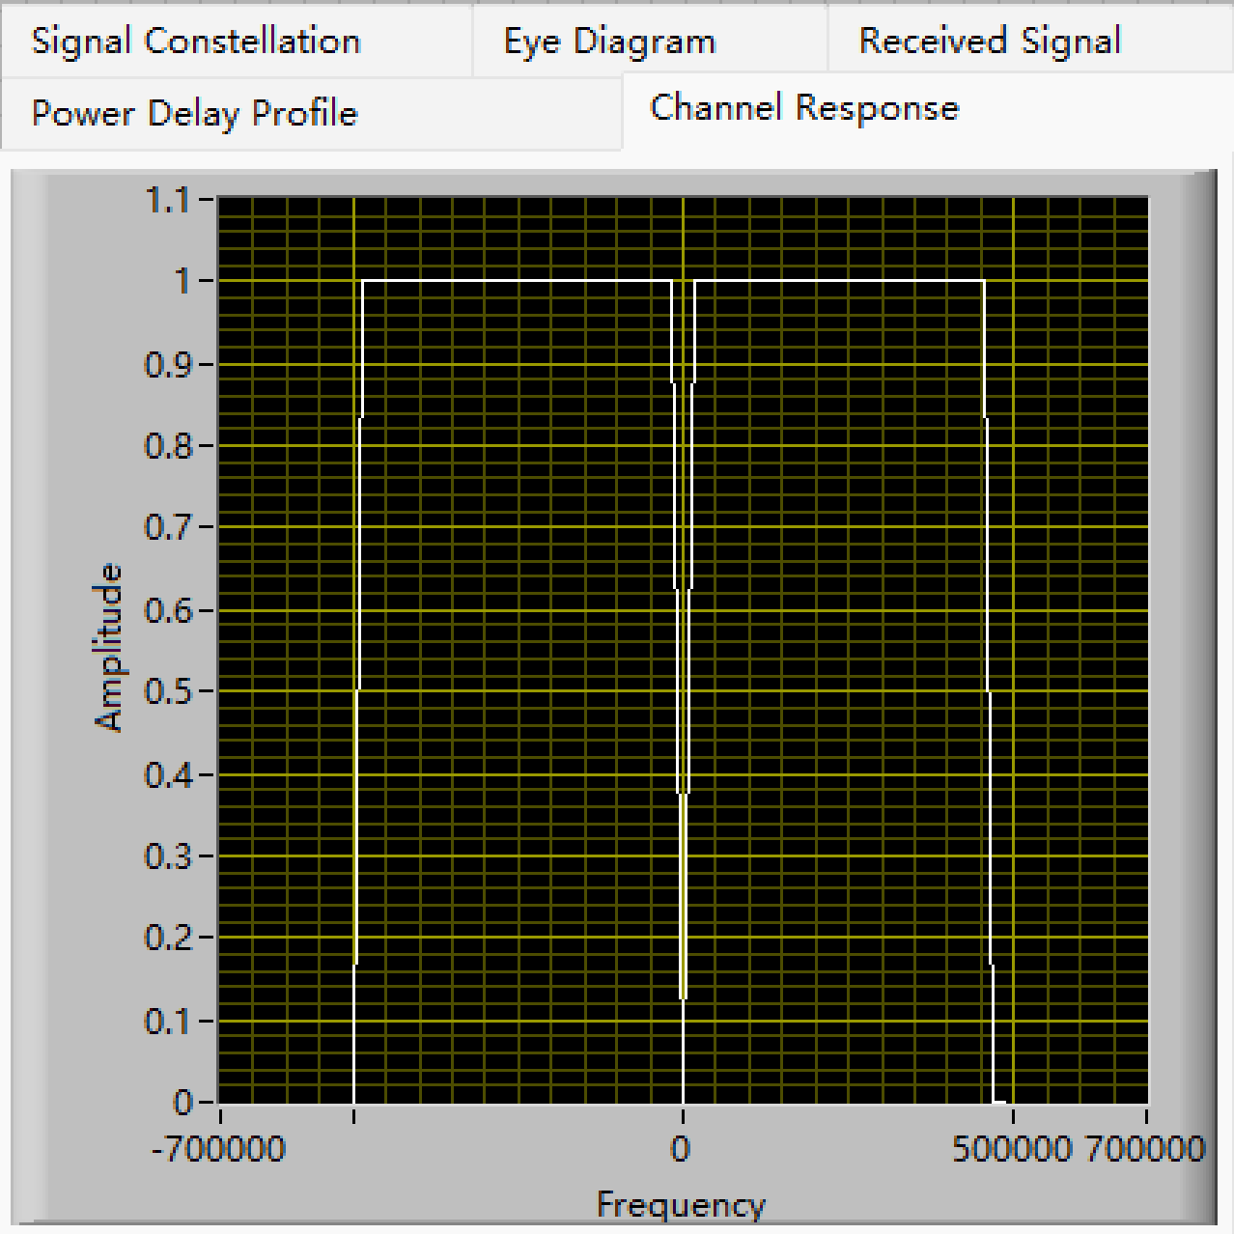
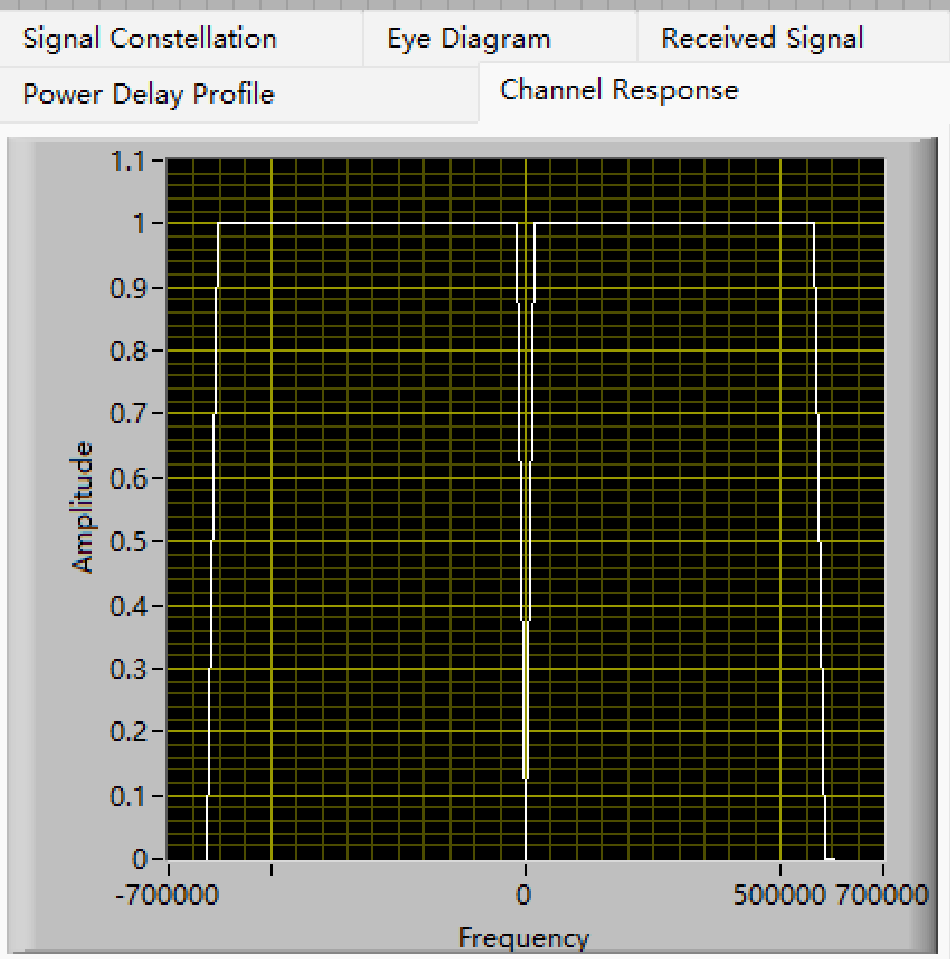
Task2: Frequency Selectivity of Wireless Channels——Simulation
SampleRate=2MHz
SampleRate=4MHz
SampleRate=5MHz
EE313: Wireless Communications
26

Slide 27
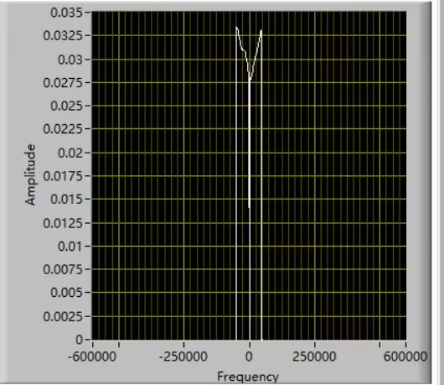
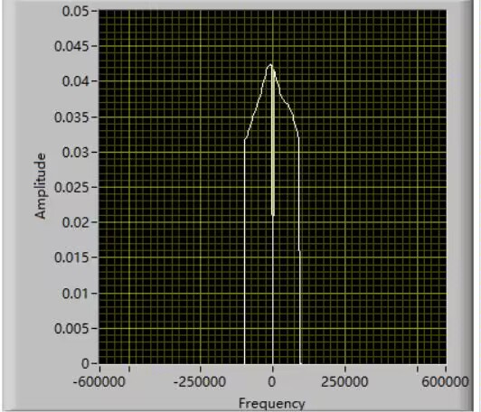
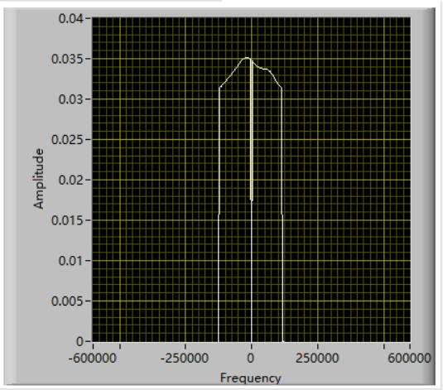
Task2: Frequency Selectivity of Wireless Channels——USRP Experiment
SampleRate=400KHz
SampleRate=800KHz
SampleRate=1MHz
EE313: Wireless Communications
27

Slide 28
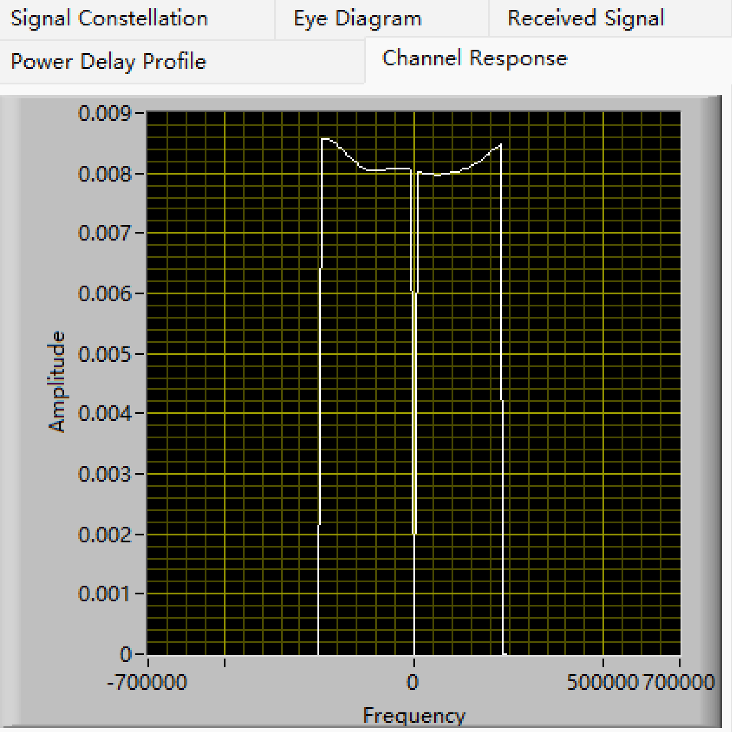
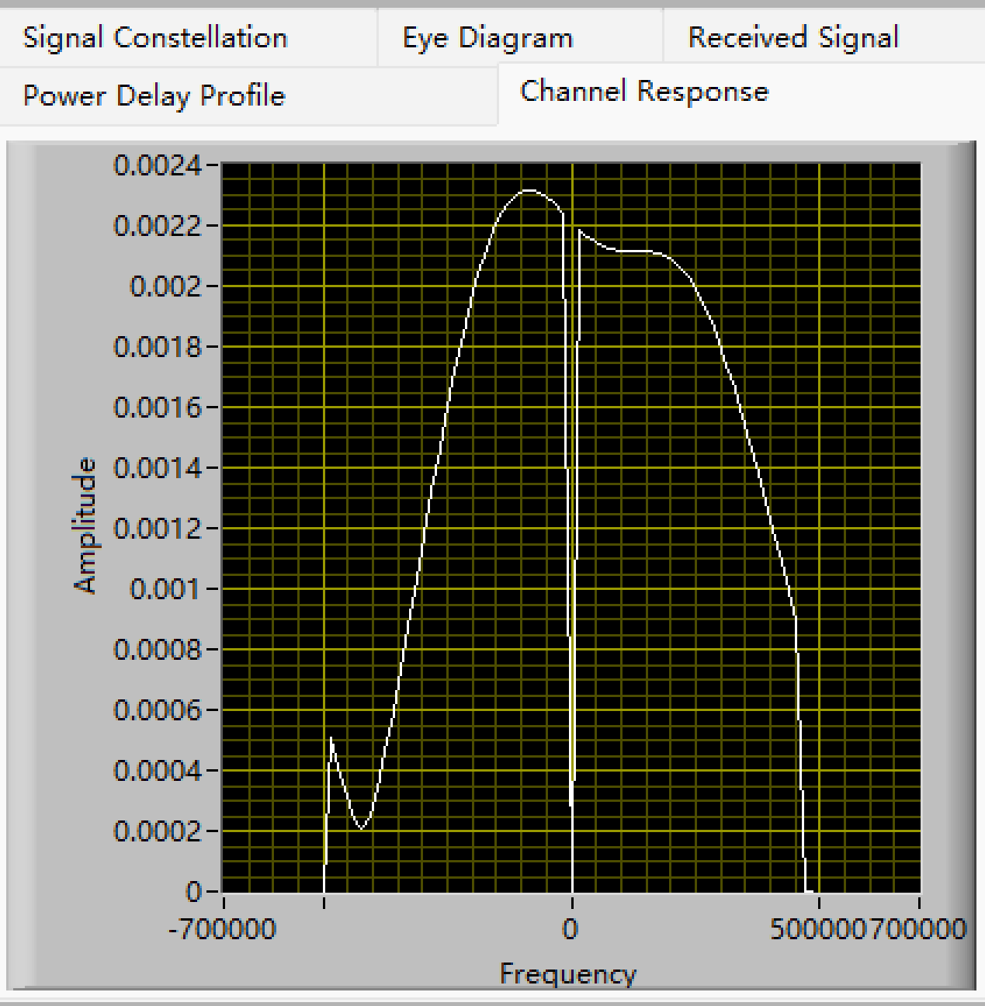
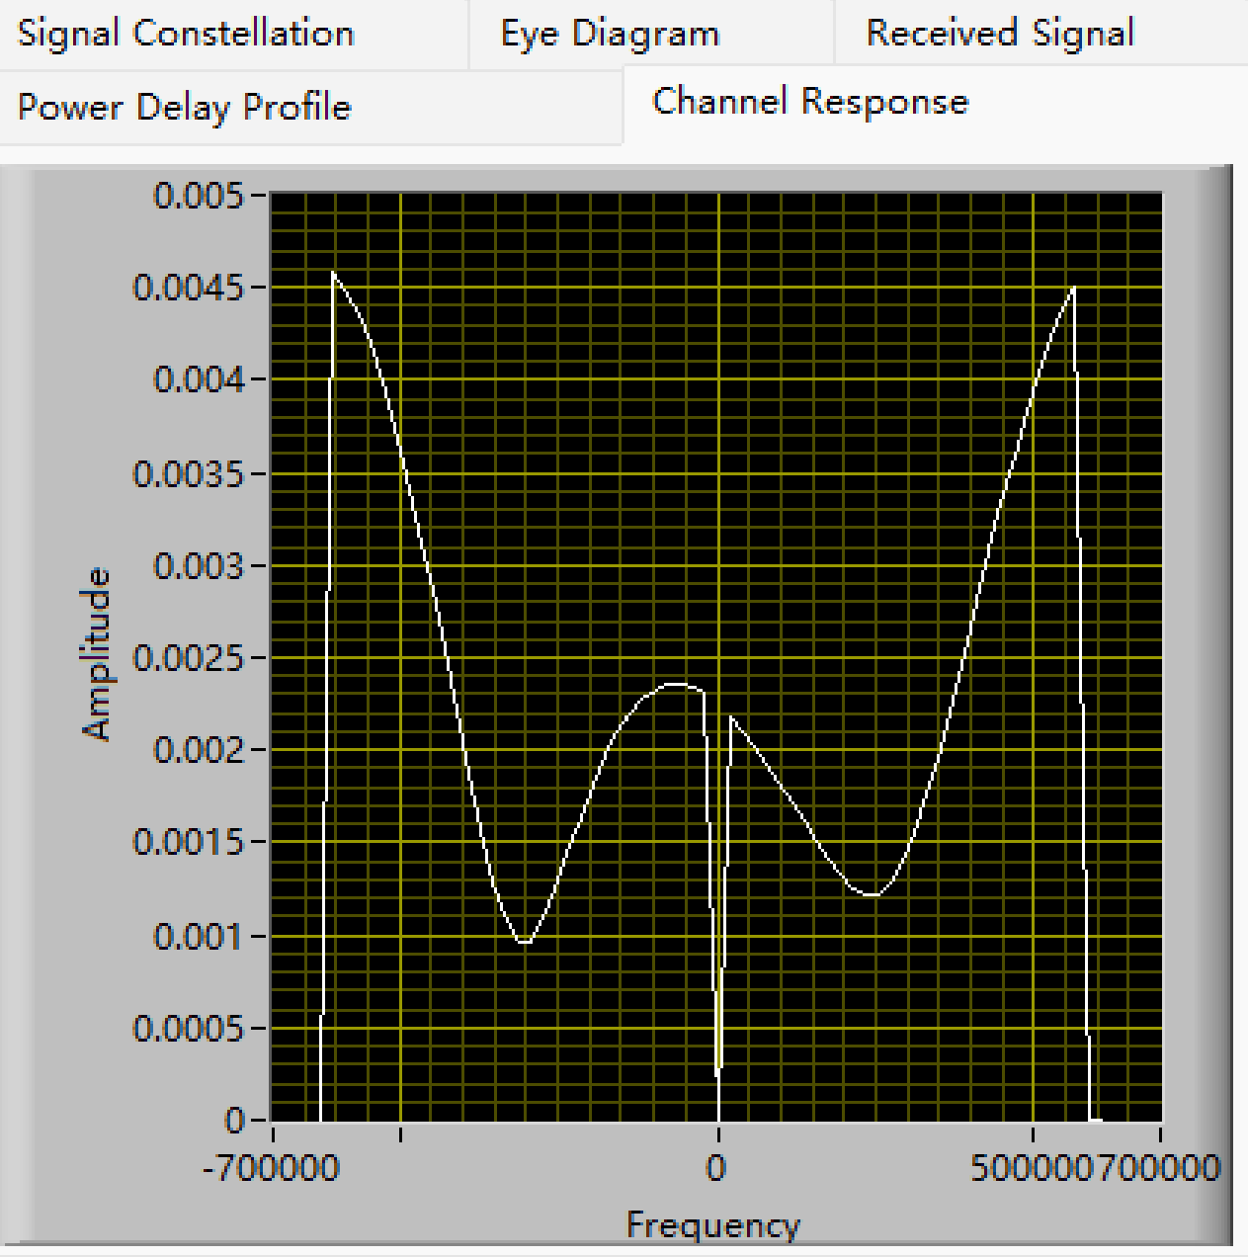
Task2: Frequency Selectivity of Wireless Channels——USRP Experiment
SampleRate=2MHz
SampleRate=4MHz
SampleRate=5MHz
EE313: Wireless Communications
28

Slide 29
Task3: Sensitivity to Frequency Offsets——Simulation
EE313: Wireless Communications
29

Slide 30
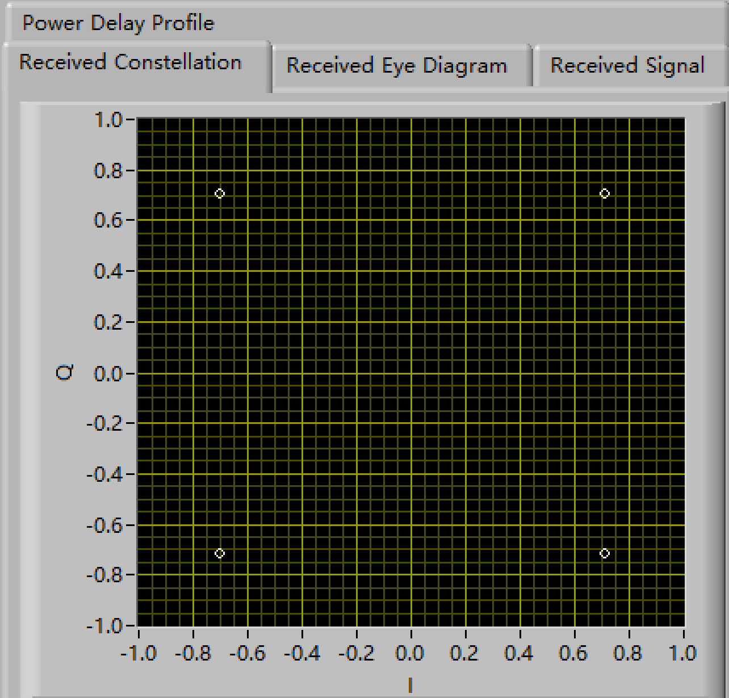
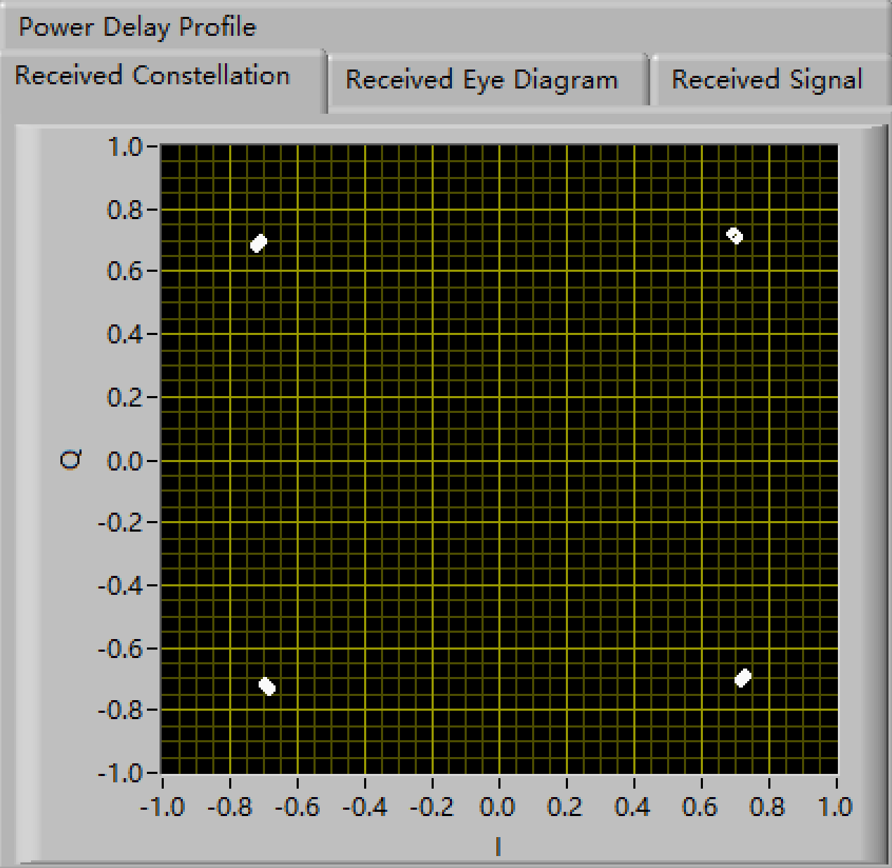

Task3: Sensitivity to Frequency Offsets——Simulation
Under [10 4 10 4] N=64
Frequency Offset=0Hz
Frequency Offset=10Hz
Frequency Offset=20Hz
EE313: Wireless Communications
30

Slide 31

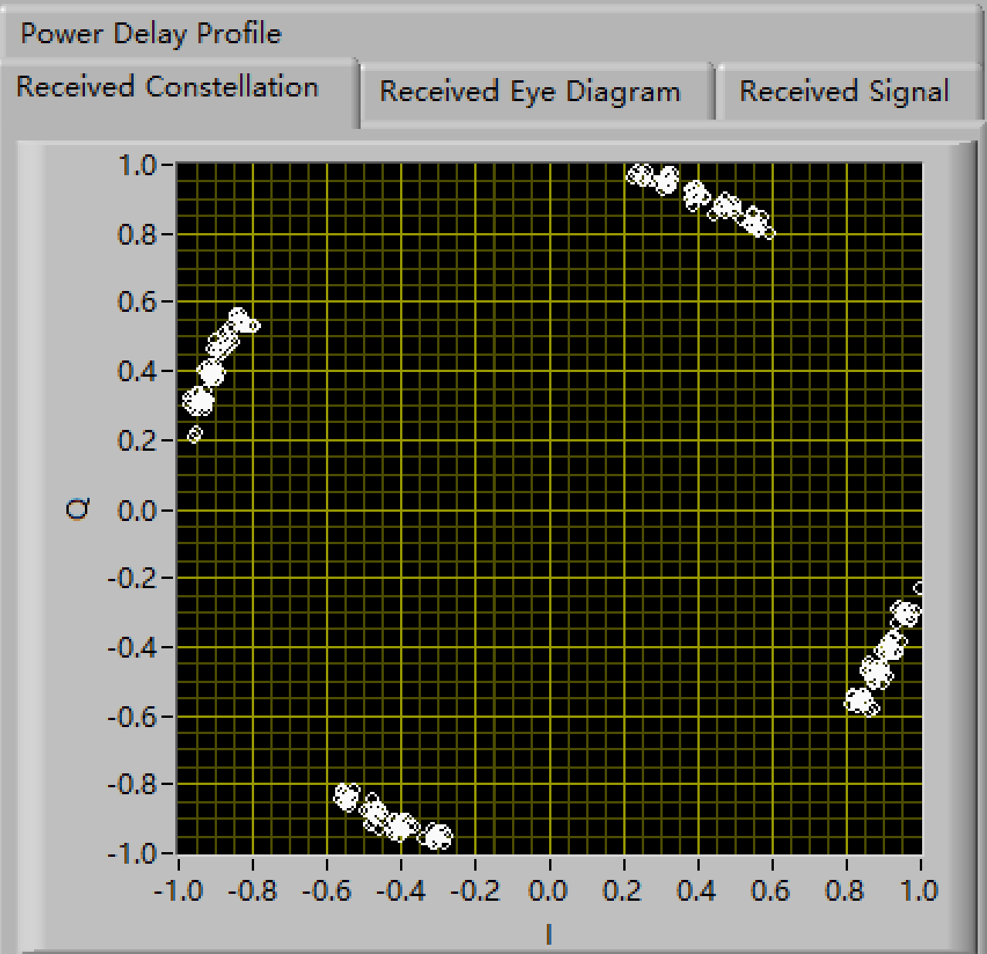
Task3: Sensitivity to Frequency Offsets——Simulation
Under [10 4 10 4] N=64
Frequency Offset=30Hz
Frequency Offset=200Hz
EE313: Wireless Communications
31

Slide 32

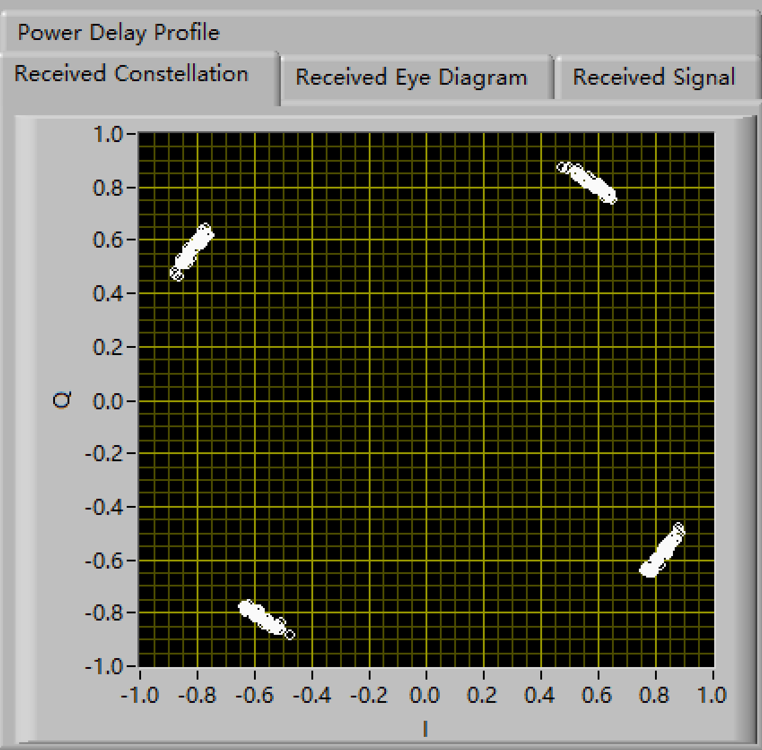
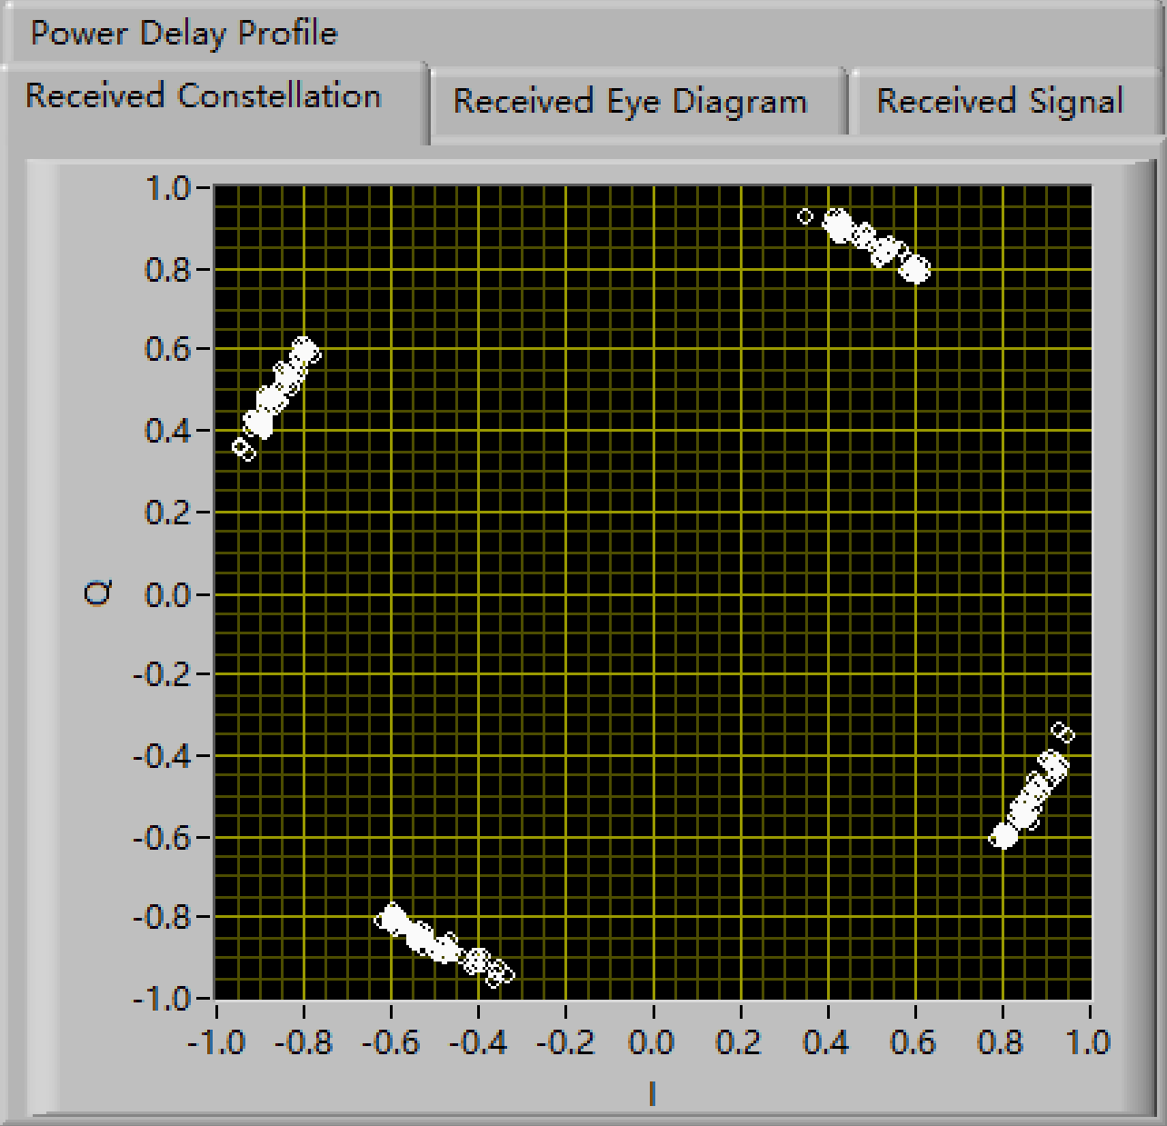

Task3: Sensitivity to Frequency Offsets——Simulation
Under [20 20 4 4] N=64
Frequency Offset=50Hz
Frequency Offset=50Hz
Frequency Offset=100Hz
Frequency Offset=100Hz
Frequency Offset=150Hz
Frequency Offset=150Hz
Frequency Offset=200Hz
EE313: Wireless Communications
32

Slide 33

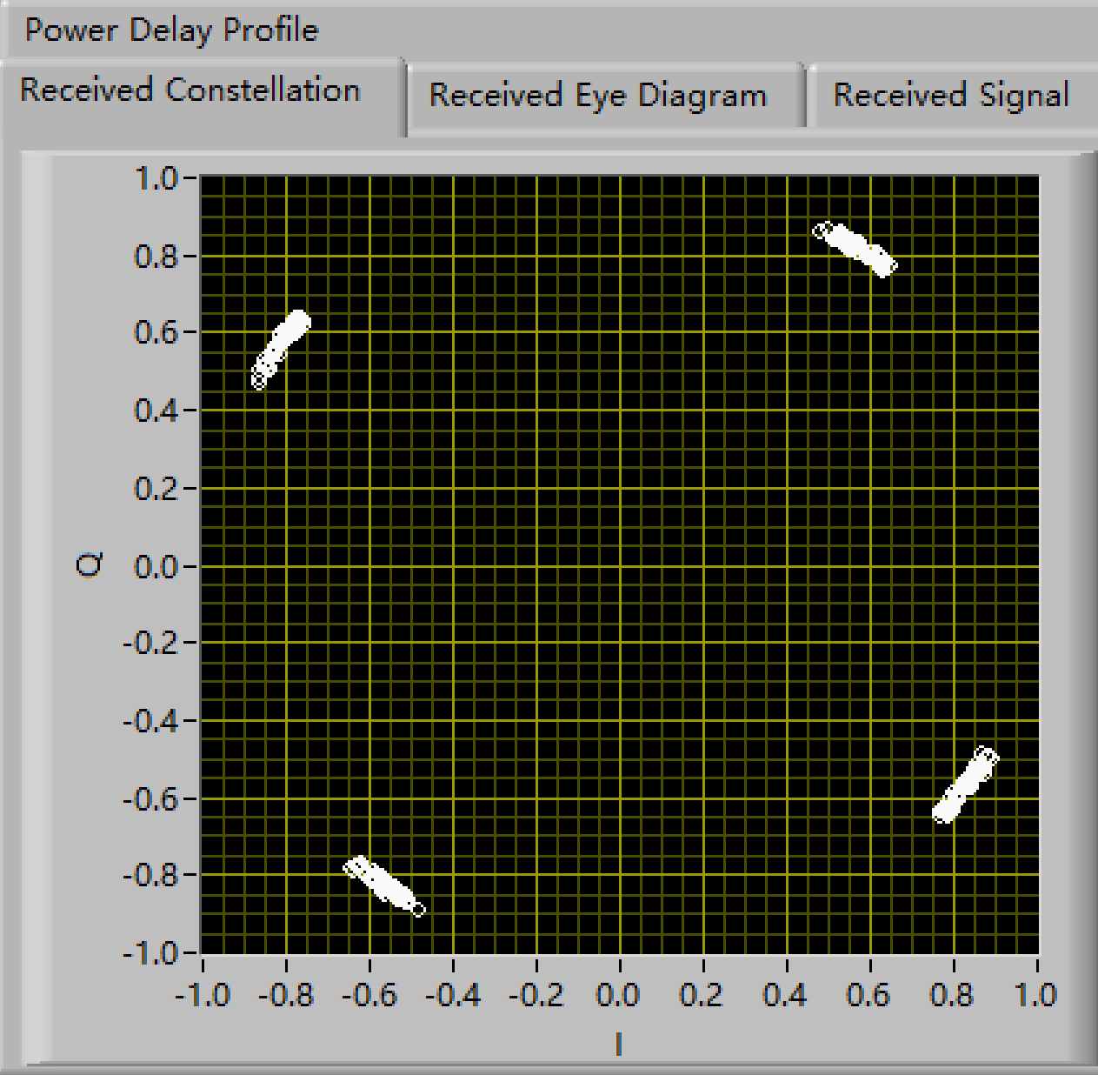
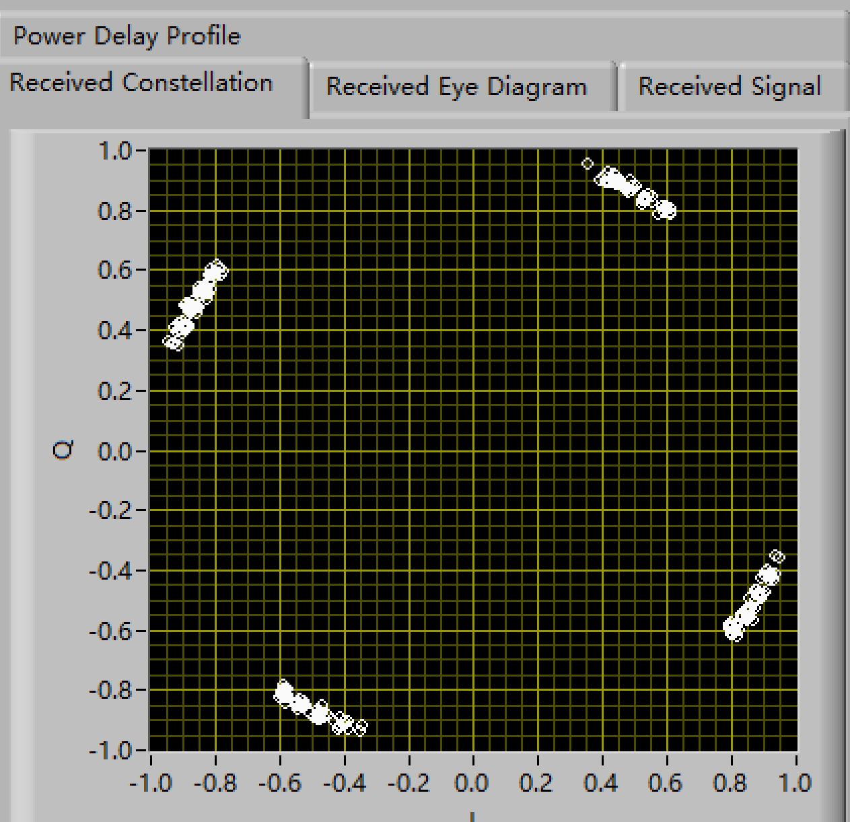
Task3: Sensitivity to Frequency Offsets——Simulation
Under [4 4 4 4] N=1024
Frequency Offset=50Hz
Frequency Offset=100Hz
Frequency Offset=150Hz
EE313: Wireless Communications
33

Slide 34
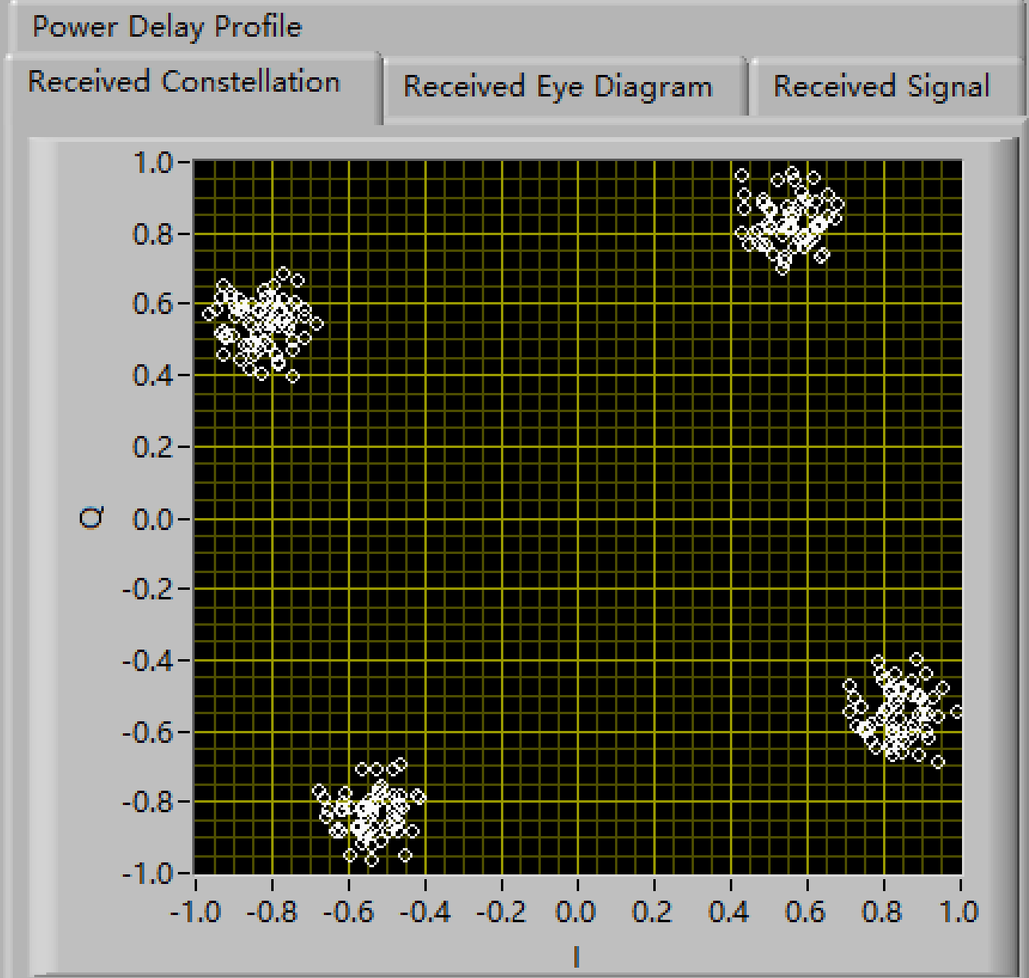
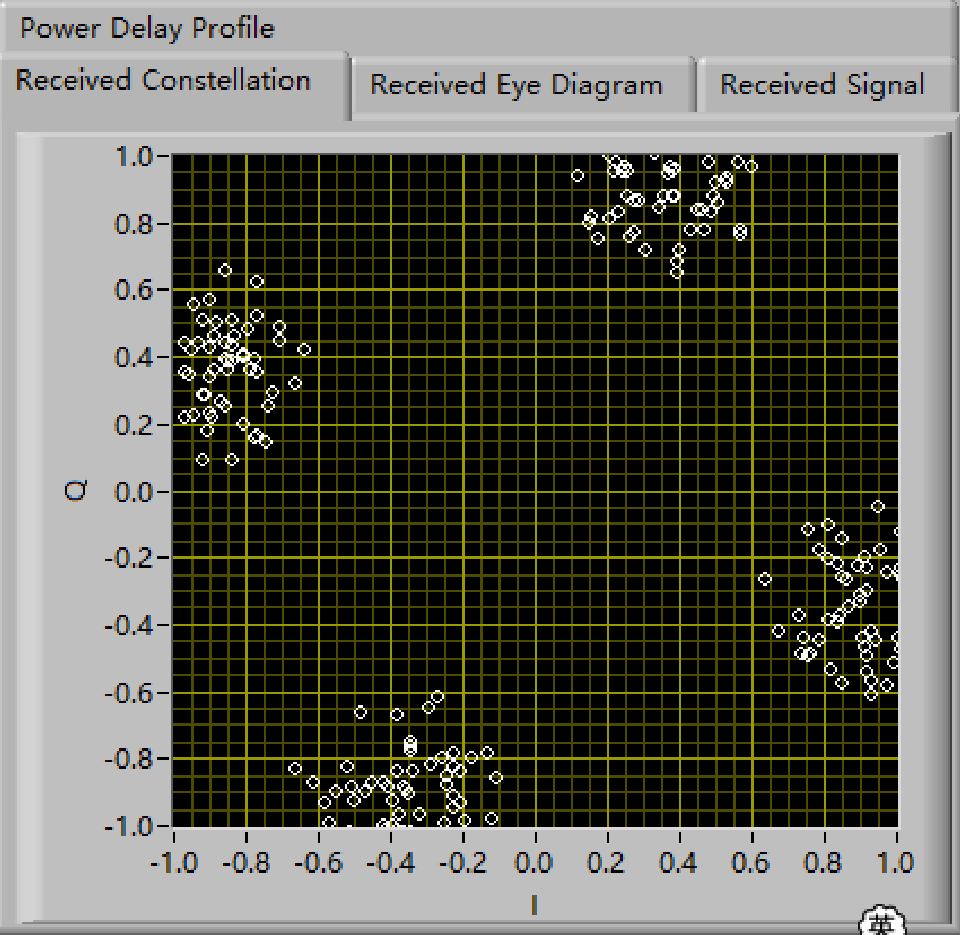
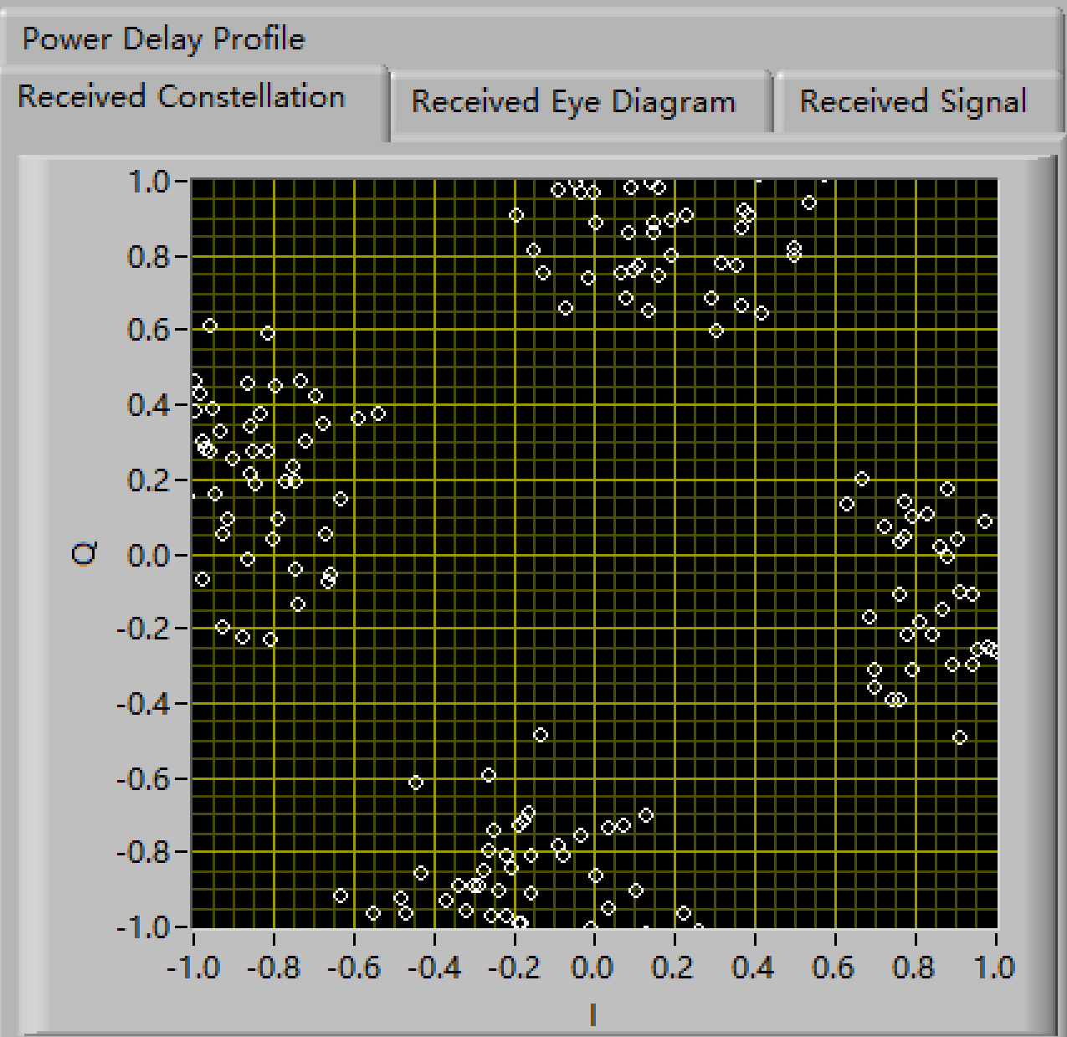
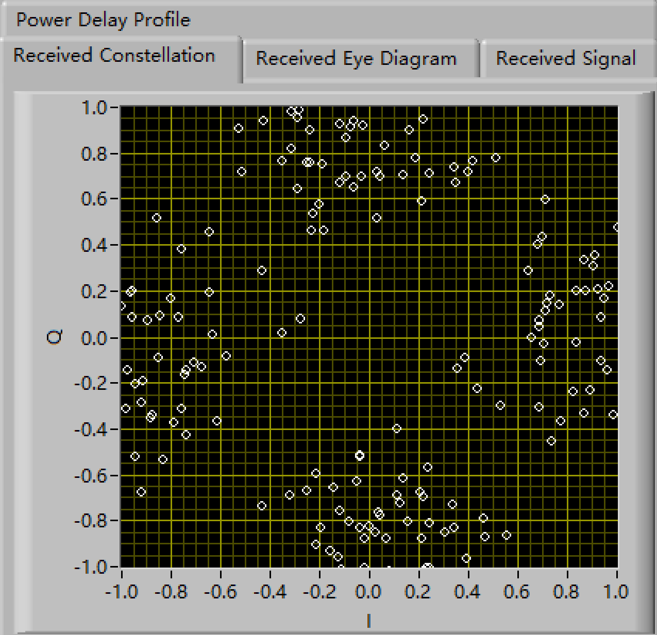
Task3: Sensitivity to Frequency Offsets——Simulation
Under [20 20 4 4] N=1024
Frequency Offset=50Hz
Frequency Offset=100Hz
Frequency Offset=150Hz
Frequency Offset=200Hz
EE313: Wireless Communications
34

Slide 35
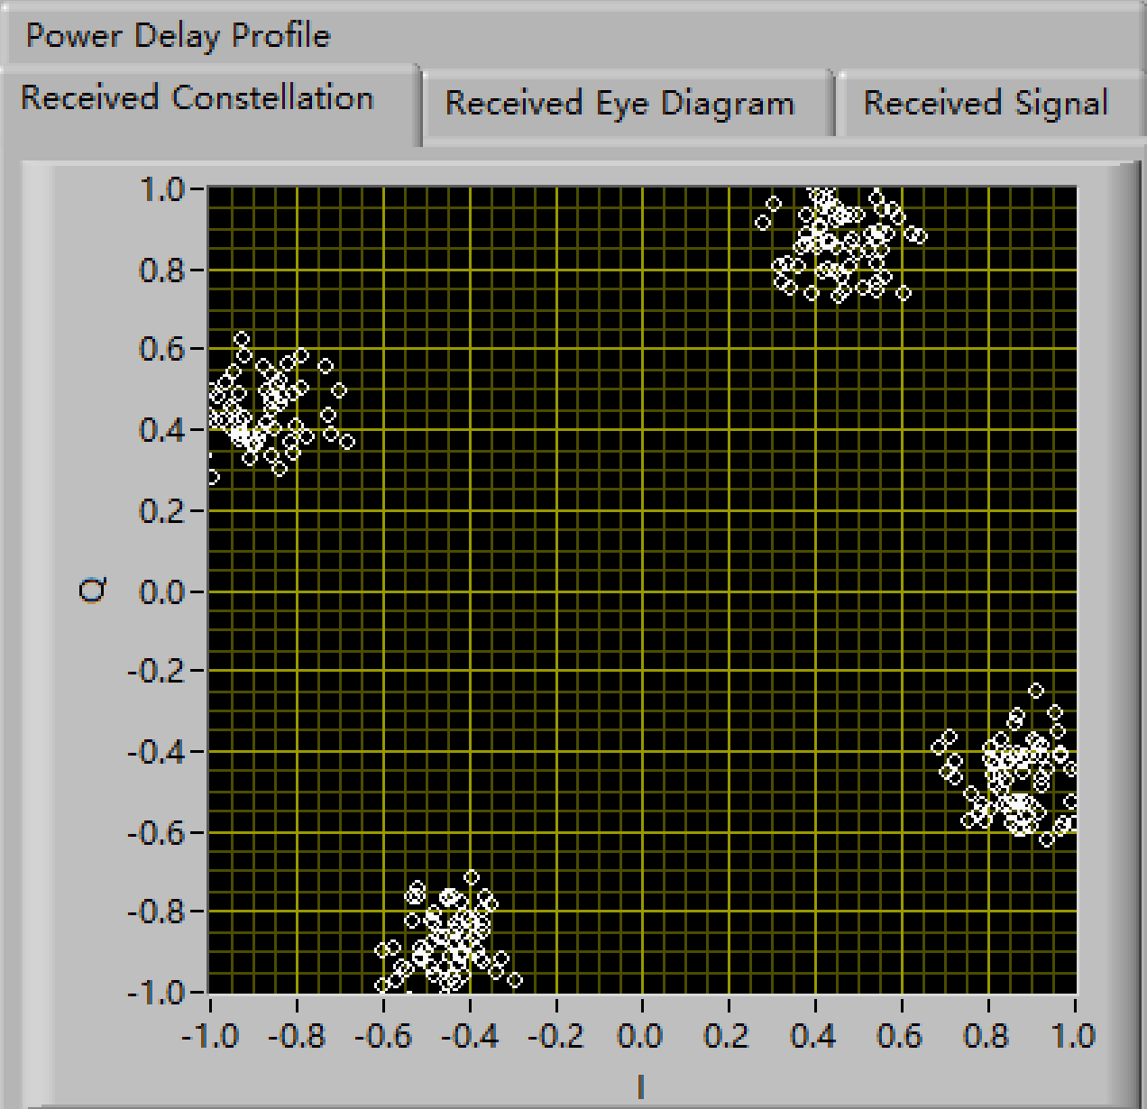
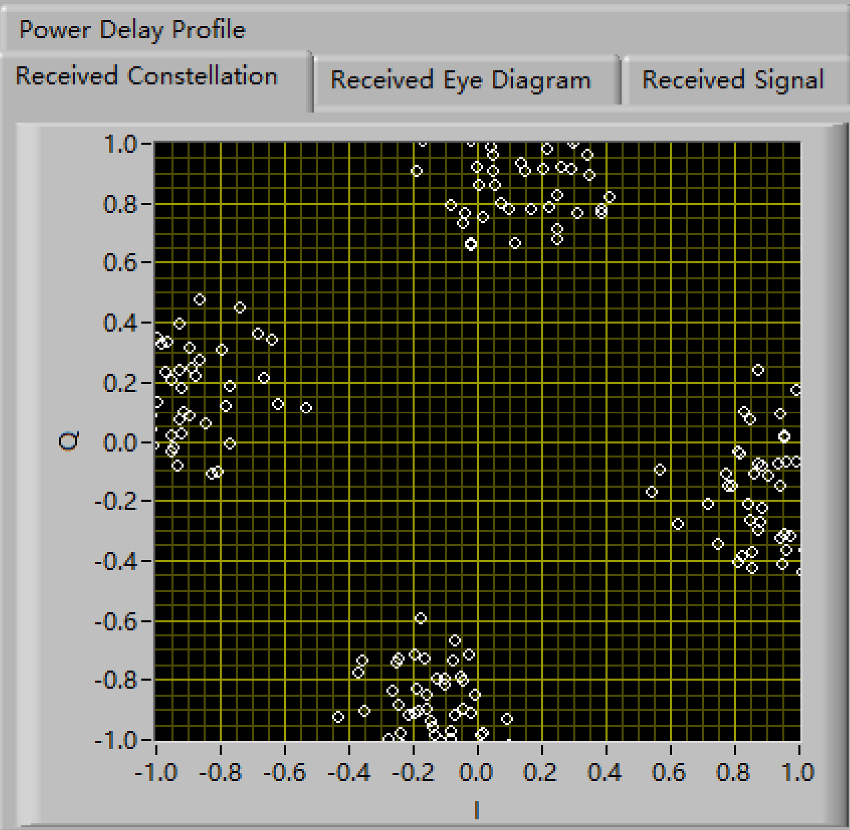
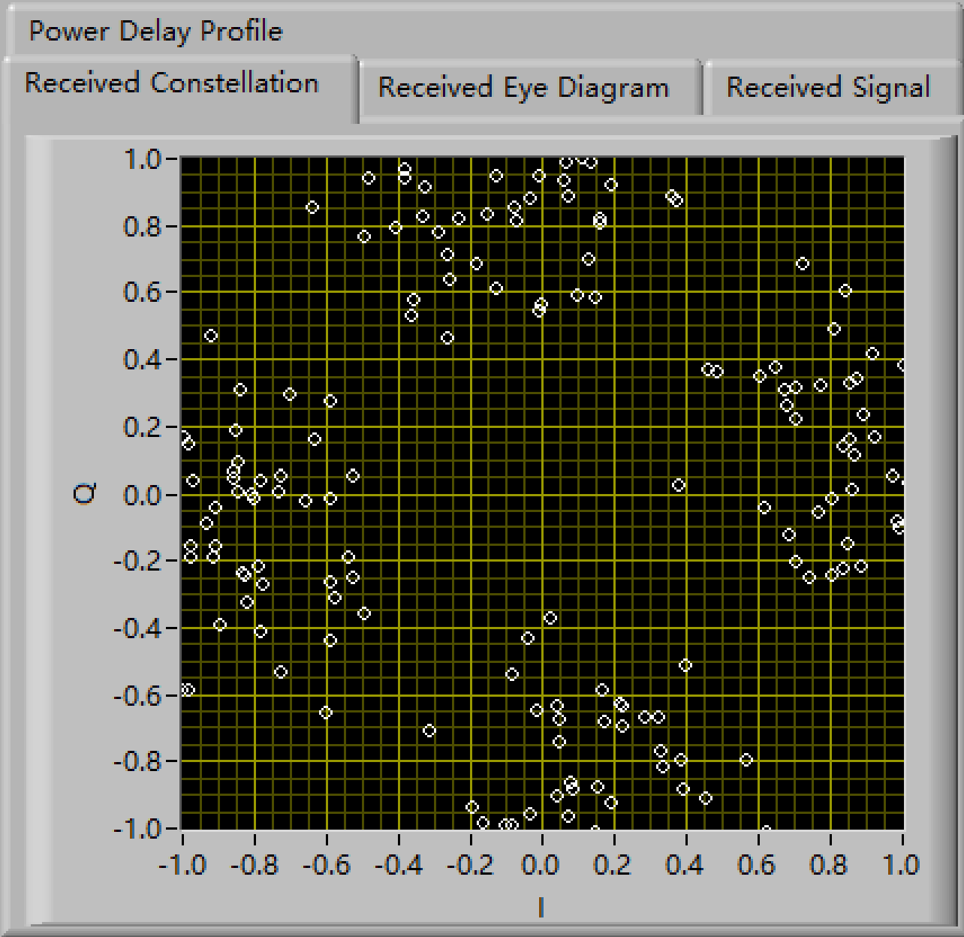
Task3: Sensitivity to Frequency Offsets——Simulation
Under [10 4 10 4] N=512
Frequency Offset=50Hz
Frequency Offset=100Hz
Frequency Offset=150Hz
EE313: Wireless Communications
35

Slide 36
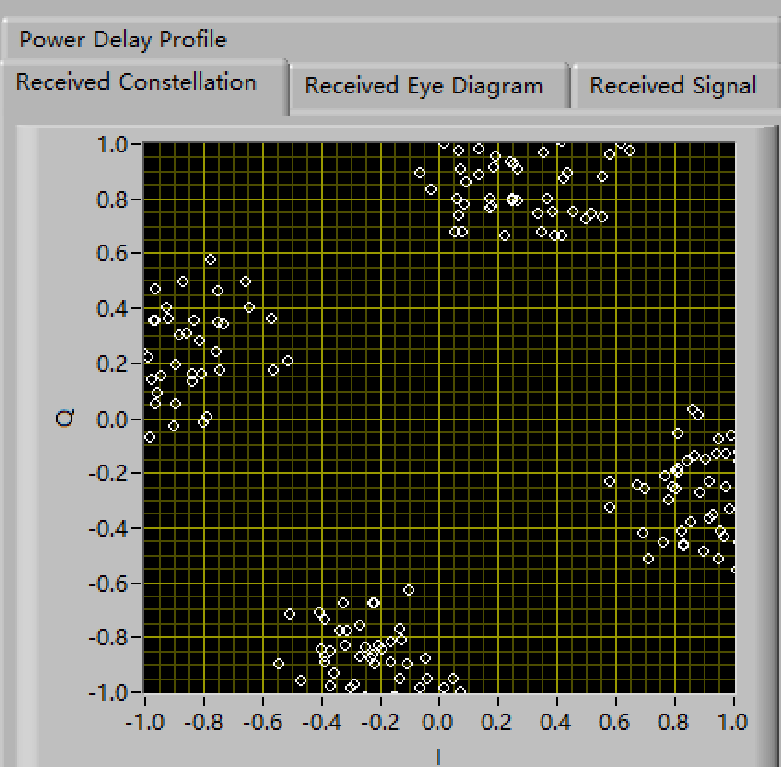


Task3: Sensitivity to Frequency Offsets——Simulation
Under [10 4 10 4] N=1024
Frequency Offset=50Hz
Frequency Offset=100Hz
Frequency Offset=150Hz
As the number of subcarriers increases, the recovery quality becomes worse.
EE313: Wireless Communications
36

Slide 37
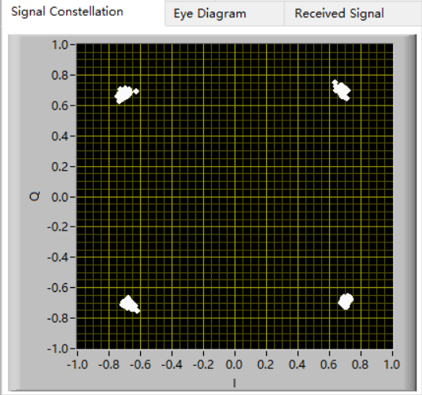
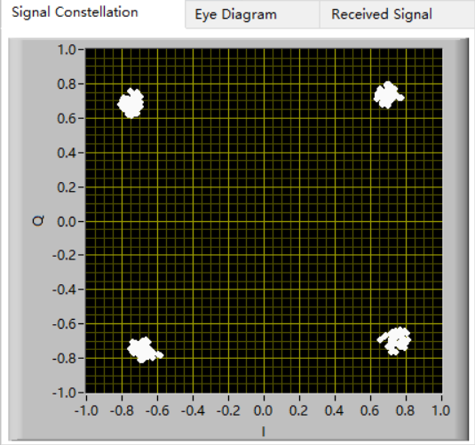
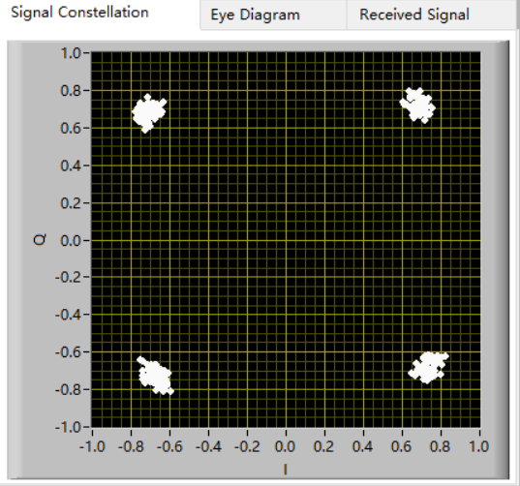
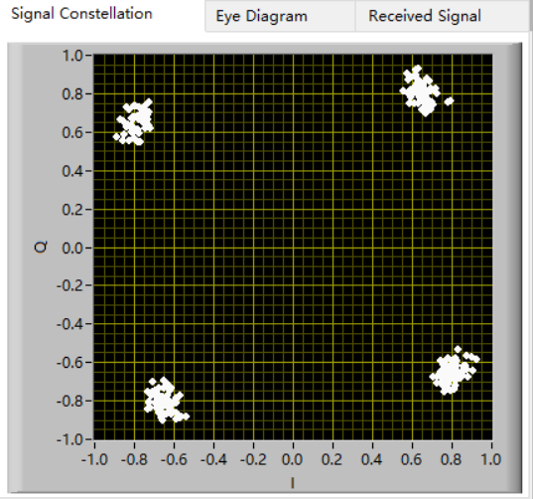
Task3: Sensitivity to Frequency Offsets——USRP Experiment
Under [10 4 10 4] N=64
Frequency Offset=0Hz
Frequency Offset=10Hz
Frequency Offset=20Hz
Frequency Offset=30Hz
EE313: Wireless Communications
37

Slide 38



Task3: Sensitivity to Frequency Offsets——USRP Experiment
Under [10 4 10 4] N=512
Frequency Offset=50Hz
Frequency Offset=100Hz
Frequency Offset=150Hz
EE313: Wireless Communications
38

Slide 39



Task3: Sensitivity to Frequency Offsets——USRP Experiment
Under [10 4 10 4] N=1024
Frequency Offset=50Hz
Frequency Offset=100Hz
Frequency Offset=150Hz
EE313: Wireless Communications
39

Slide 40

Task3: Sensitivity to Frequency Offsets——USRP Experiment
Problem
Under [10 4 10 4] N=512 50Hz
Capture time = 500u
Capture time = 4.8m
EE313: Wireless Communications
40

Slide 41

Task3: Sensitivity to Frequency Offsets——USRP Experiment
Problem
Under [10 4 10 4] N=1024 50Hz
Capture time = 2.4m
Capture time = 4.8m
EE313: Wireless Communications
41

Slide 42
04
PART
Advanced Task
EE313: Wireless Communications
42

Slide 43


Advanced Task1 — High-order Modulation
modulate_proj.vi
16QAM Modulation
EE313: Wireless Communications
43

Slide 44


Advanced Task1 — High-order Modulation
decode_proj.vi
16QAM Demodulation
EE313: Wireless Communications
44

Slide 45

Advanced Task1 — 64QAM
64QAM Modulation
EE313: Wireless Communications
45

Slide 46

Advanced Task1 — 64QAM
64QAM Demodulation
EE313: Wireless Communications
46

Slide 47


Advanced Task1 — Simulator
16QAM
64QAM
EE313: Wireless Communications
47

Slide 48


Advanced Task1 — USRP
16QAM
64QAM
EE313: Wireless Communications
48

Slide 49


Advanced Task1 — Video
16QAM
64QAM
EE313: Wireless Communications
49

Slide 50


Advanced Task2 — Image Transmission
Source(Image).vi
Image source
EE313: Wireless Communications
50

Slide 51

Advanced Task2 — Image Transmission
Image recover
EE313: Wireless Communications
51

Slide 52


Advanced Task2 — Simulator
Transmitted image
Recovered image
EE313: Wireless Communications
52

Slide 53


Advanced Task2 — USRP
Image recover
EE313: Wireless Communications
53

Slide 54

Advanced Task2 — Video
Image Transmission
EE313: Wireless Communications
54

Slide 55
THANKS
EE313: Wireless Communications
55

Slide 56
Q&A
EE313: Wireless Communications
56

